Slide 1

Requirements Documentation

Slide 2
Studies indicate that between 40% and 60% of all defects found in software projects can be traced back to errors made while gathering requirements
Imagine you are about to build a house…
You're not sure exactly what you want to build, but you know you want a “nice” house, a “big” house, and you know that you have a budget of €200,000.
So, the first thing you do is go to the lumberyard and purchase various materials - lumber, windows, doors, drywall, roofing and cement blocks. You get the materials delivered and you grab the first 2x4 and start building the house.

Slide 3
Blueprints? Who needs them?
You know what you are doing and you've been inside a lot of houses right? This notion, of course, seems absurd, but that's exactly the way most software applications are built today.
Developers talk to the client for a few minutes, get a general idea of what the client needs, and then sit down at the computer and start to code…

Slide 4
The earlier you discover the problems, the less time is wasted and the fewer things are affected.
If we take a look back at the house example, think about this: how much quicker and cheaper would it be to change the blueprint and build a two-story house rather than to build a one-story house and then rip off the roof to add the second story?
The typical outcome of incomplete requirements is a huge gap between what the developers think they are supposed to build and what the users think they will get.
This, of course, makes the software take longer to build and drives the cost up.

Slide 5
Functional requirements describe the functionality of the product.
They describe exactly what tasks the software must perform.
Functional requirements define the scope of the system, the product boundaries, and its connections to adjacent systems.
Functional requirements also define the business rules.
Business rules are the rules that the system must conform to, based on the individual business.
This includes defining the data that must be tracked.
The business rules are the most important type of functional requirements and most of your requirements will be of this type.

Slide 6
Non-Functional requirements describe the look and feel of the system.
This includes the visual properties of the system, its usability, and the performance requirements - how big, how fast, etc.
Non-Functional requirements also include the product's intended operating environment and any maintainability, portability and security issues.
Non-Functional requirements also include cultural and political issues as well as legal requirements that the software must conform to.

Slide 7
Good requirements have the following attributes. They are:
Complete - they very thoroughly describe the criteria
Correct - they are accurate and true
Feasible - they can be accomplished and individual requirements do not contradict each other.
Necessary - they are truly needed for the system to function properly and they are really what the client wants.
Prioritized - in the case that not all parts of the system can be implemented at the same time, it's important to be able to distinguish “absolutely necessary” from “nice to have”.
Unambiguous - they are clear and cannot be misinterpreted
Verifiable - once implemented, it can be confirmed that the system has met the requirement through observation and testing

Slide 8
Quality and accuracy are extremely important
One methodology for collecting requirements is to write each requirement on a separate 5" x 7" index card.
Using these cards is an excellent way to begin the requirements collection process, and the cards have some other advantages, as well.
They are a fast and easy way to group, reorganize and discard ideas.
Additionally, they can easily be sorted and distributed among different people or groups.

Slide 9
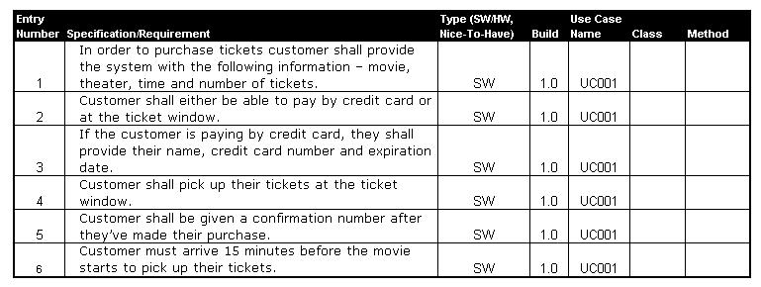

Slide 10
Use Cases
So, now that we have a complete organized list of requirements, I guess we're ready to start coding, right?
The requirements really just give us an outline of what we are trying to build.
Use Cases are the next step in the design process.
Use cases integrate the requirements into a comprehensive package that describes the interaction of the user with the system.

Slide 11
Use Cases
Use Cases are text documents, written in plain English, which describe a scenario in which an “Actor” interacts with the “System”.
The name “Actor” is slightly deceiving since an actor isn't always a person.
Often, the actor is simply another computer system or other hardware. The actors are not part of the system, but are outside of it.
They are the ones interacting WITH the system.

Slide 12
Use Cases
The Use Case should describe the interaction between the actor and the system - what the actor does and how the system reacts.
Be careful to make sure the Use Case describes only how the system reacts.
While writing the Use Case, don't worry about the implementation of the system or the exact interface it will have.
An application will be described by many Use Cases (the exact number will, of course, depend on the size and complexity of the system).

Slide 13
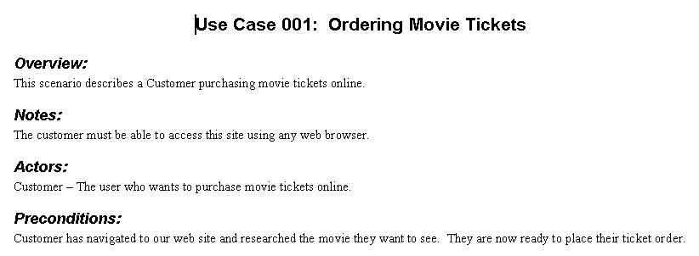

Slide 14
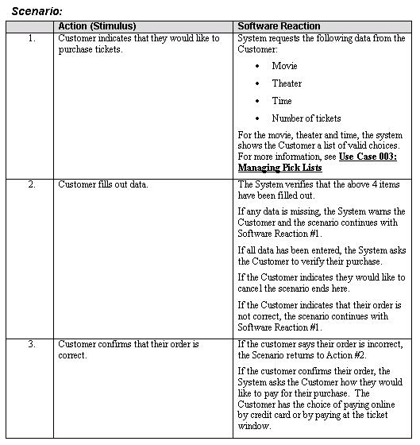

Slide 15
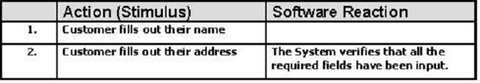
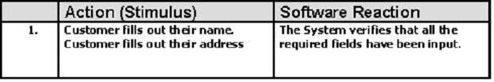
Incorrect
Correct

Slide 16
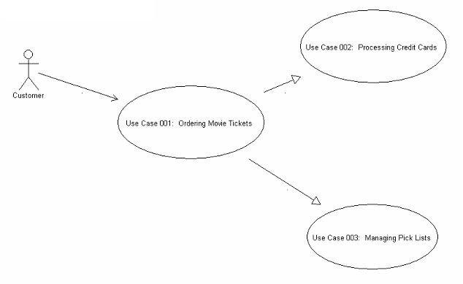

Slide 17
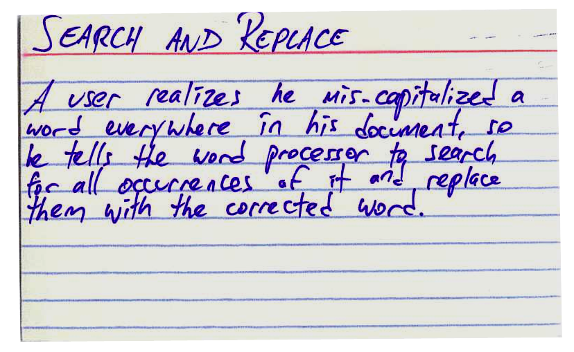

Slide 18
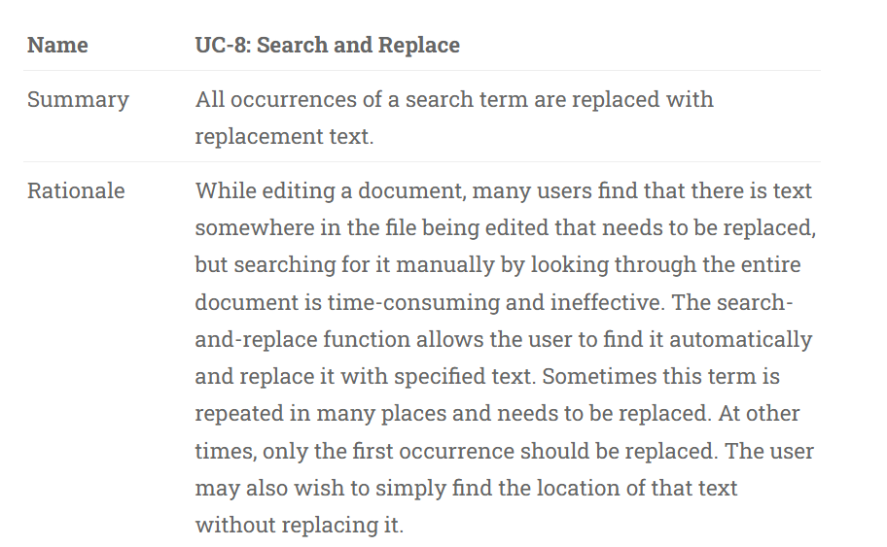

Slide 19
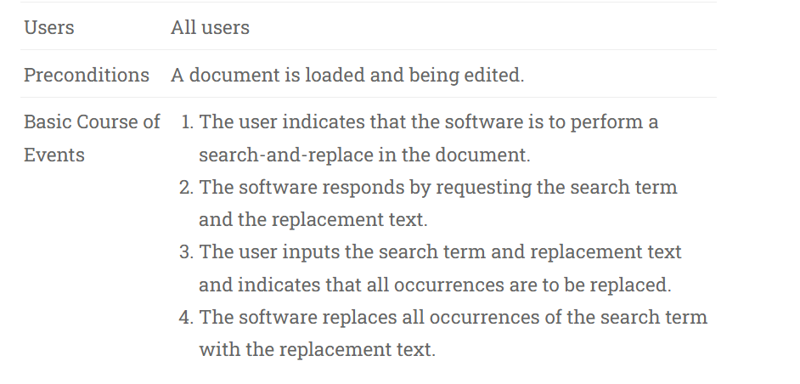

Slide 20
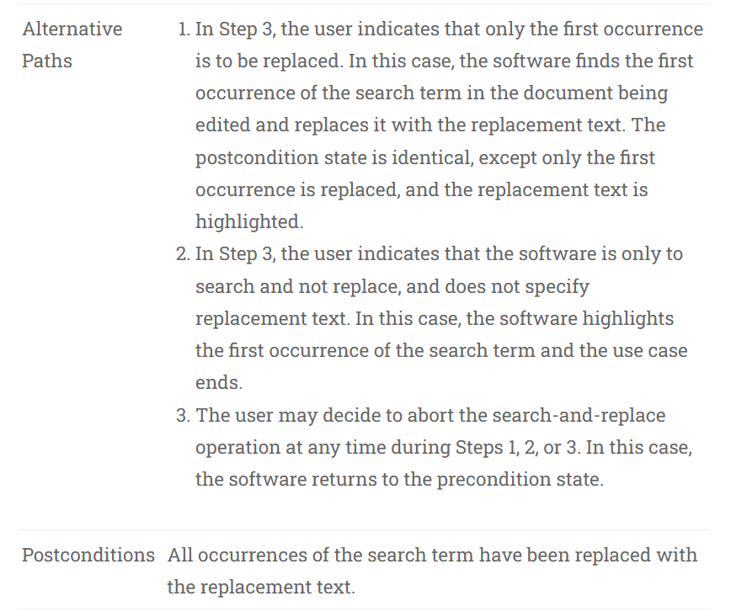

Slide 21
User stories are about needs. When you write a user story, what you’re describing is a “raw” user need. It’s something that the user needs to do in his day-to-day job. If you never build any software for him, then that need will still exist!
Use cases are about the behavior you’ll build into the software to meet those needs.
A developer who needs to build working software should be able to read a use case and get a good sense of what the software needs to do. It typically has a lot of detail, and describes everything that the developer needs to build in order to meet the user’s need. That’s why it needs to have a lot more detail, and be clear and unambiguous.

Slide 22
User stories are easy for users to read.
When you write a user story, what you’re concentrating on is writing something that anyone can understand, in the language of the users.
We all know that developers have a lot more patience for talking about details of the software they’re building than users do, which is why user stories have to be brief.
A user story needs to express a complete thought in just a couple of sentences. (That’s also why it’s good to put them on index cards: somehow, that makes it clearer that it’s self-contained and independent of the other user stories.)

Slide 23
Use cases describe a complete interaction between the software and users (and possibly other systems).
When you’re doing use case analysis, what you’re doing is designing a functional solution that meets the users’ needs.
It needs to be something that developers can implement. It’s possible that one user story could spawn several use cases. And when you combine all of your use cases into one use case document, you’ll end up with a complete description of every interaction between the user and the software that you’re planning on building. And if your software has to interact with multiple systems, you may end up treating those other systems as actors in your use case.

Slide 24
What is a user story?
A user story is a short, simple description of a feature told from the perspective of the person who desires the new capability, usually a user or customer of the system.
As a < type of user >, I want < some goal > so that < some reason >.
A user can post her resume to the web site.
A user can search for jobs.
A company can post new job openings.
A user can limit who can see her résumé.

Slide 25
As a power user, I can specify files or folders to backup based on file size, date created, and date modified.
As a user, I can indicate folders not to backup so that my backup drive isn't filled up with things I don't need saved.
As an authorized user, I can run reports so that I can see the financial state of the organization.
As an authorized user, I can run a profit and loss report…
As an authorized user, I can run a cash flow report…
As an authorized user, I can run a transaction detail report…

Slide 26
What Is the Definition of Done?
The definition of done is an agreed-upon set of things that must be
true before any product backlog item is considered complete.
every product backlog item for a particular product must satisfy the definition of done criteria to be considered potentially shippable.

Slide 27
the code is well-written. That is, the team does not feel they need to immediately refactor or rewrite it.
the code is checked in.
the code comes with automated tests at all appropriate levels.
the code has been either pair programmed or has been code inspected.
the feature the code implements has been documented as needed in any end-user documentation.

Slide 28
What Are Some Examples of Conditions of Satisfaction?
To understand the difference between conditions of satisfaction and definition of done, it might be helpful to look at some examples.
Consider a user story such as, "As a user, I am required to login before using the site." That user story might include these conditions of satisfaction:
user is logged in only when proper credentials are provided
a "remember me" option is available
user can request a password reminder
user is locked out after three failed attempts

Slide 29
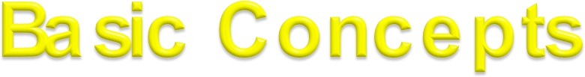
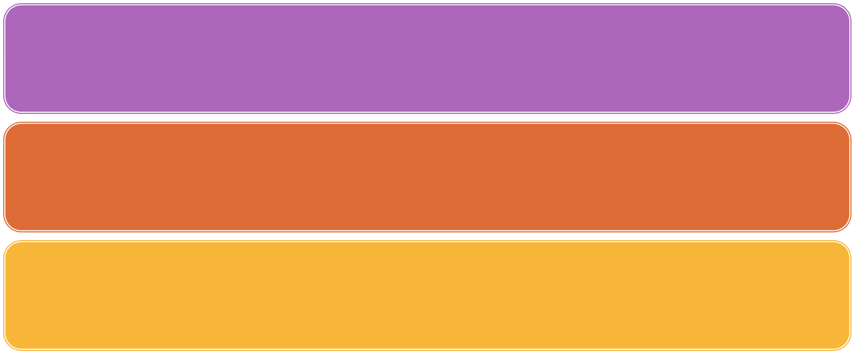
To fully understand the purpose of a system you have to know who the system is for, and who will use it.
In Object theory, the different types of users are represented by actors.
Any other system which interacts with the system being developed is also represented by an actor;
thus actors delimit the system.
An action is an atomic set of activities, which is performed either entirely, or not at all.

Slide 30
The functionality of a system is defined by use cases, each of which represents a specific way to use the system, that is, the behaviour of the system.
The description of a use case defines WHAT happens in the system when the use case is performed, not HOW it is performed.
When an actor uses the system, the system performs a use case.

Slide 31
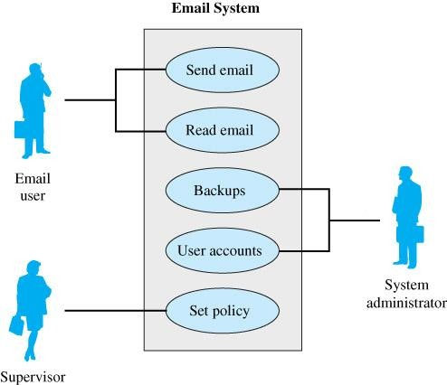
 Use Case Diagrams model at a high level
Models how users interact with major components
of a system
UC diagrams are somewhat akin to a Context Diagram in DFDs.

Slide 32
 Describe basic functions of the system
What the user can do
How the system responds
Logical models: describe the activities of a system without specifying how the activities are implemented.
Developed working with users for content.

Slide 33
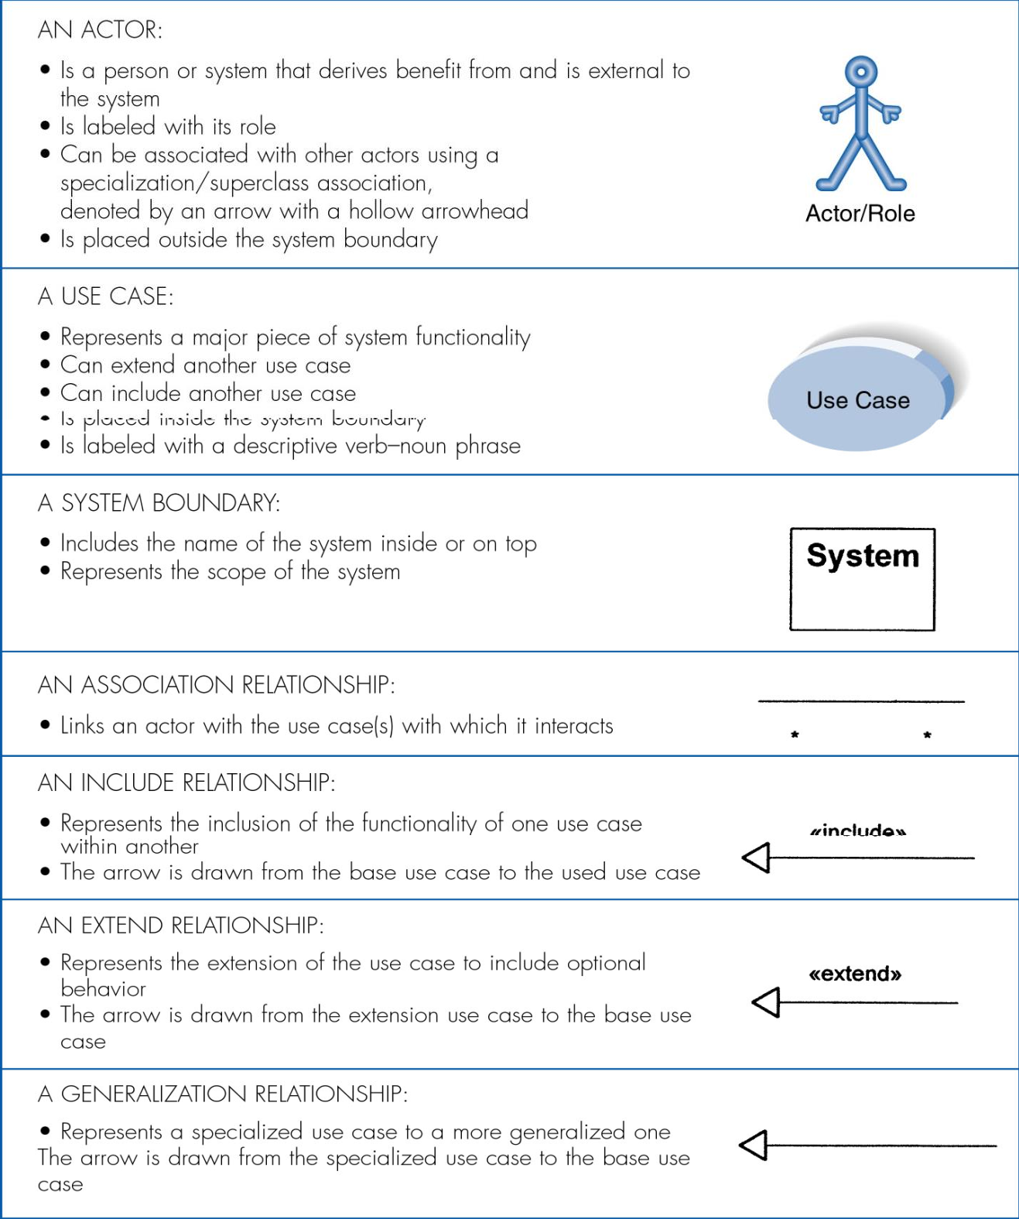
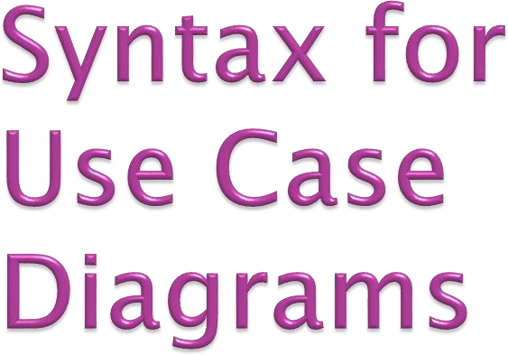

Slide 34
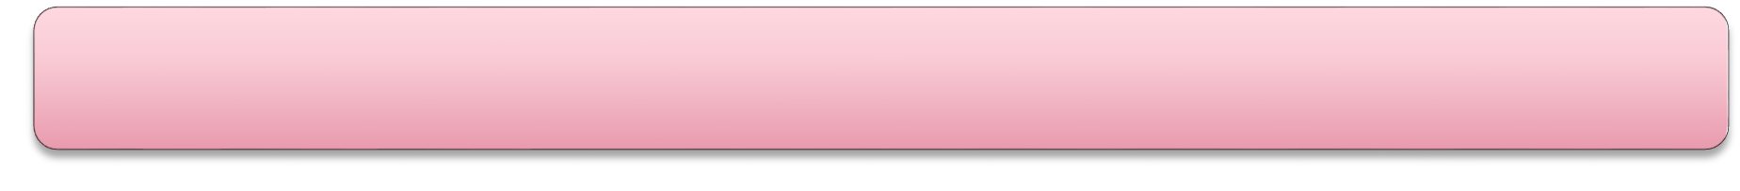

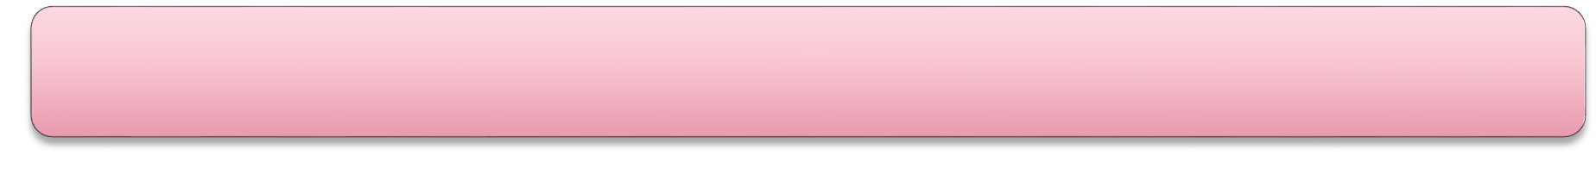
Start with system boundary
Place elements in order to be easy to read Place actors on the diagram
Conclude by connecting actors to use cases by lines

Slide 35


Actors are not part of the system. It is outside the
They represent roles a user of the system can play.
system.
Actor
An actor can actively interchange information with the system.
An actor can be a passive recipient of information or it can be a giver of information.
System

Slide 36

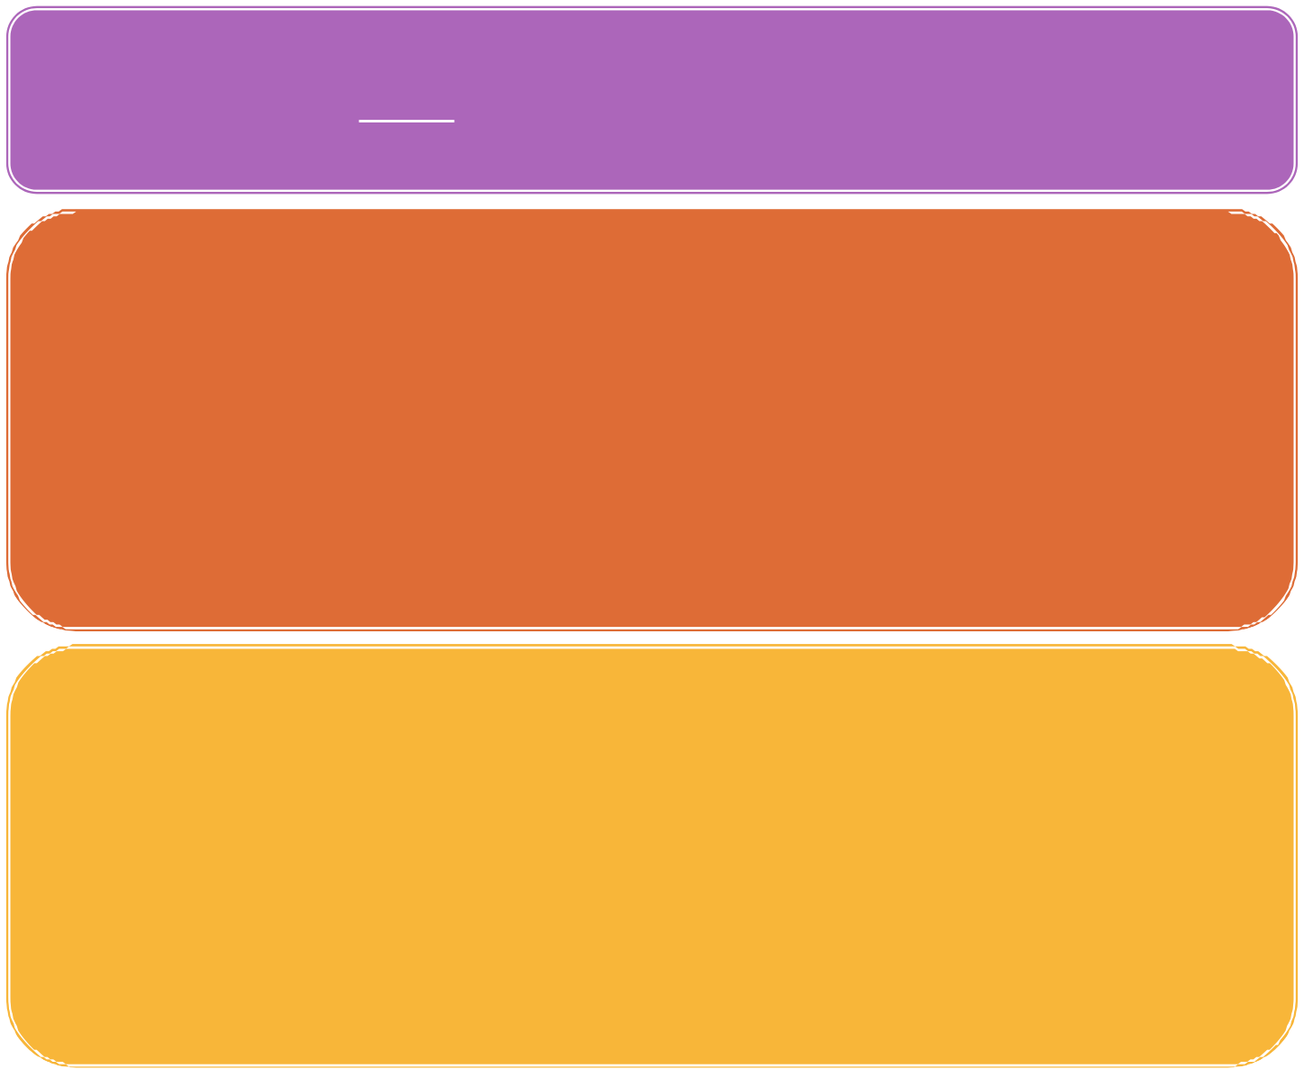
An Actor is a role, not a particular person or thing.
The name of the actor should represent, as clearly as possible, the actors role, for example ‘operator’, or ‘subscriber’. Make sure that there is little risk of confusing one actors name with another at a future stage of the work.
Actor
The difference between an actor and a user of the system is that an actor represents a particular type of user rather than a real physical user. The same user can act as several different actors.
Several users can act as the same actor.

Slide 37
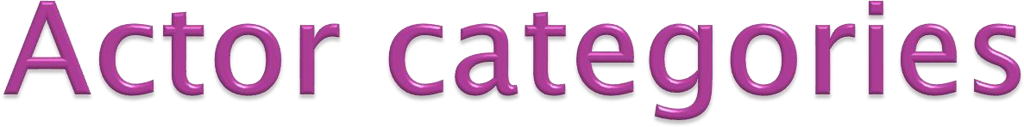
Primary (human) users that execute the main functionality
Human users that execute the secondary functions of the system, such as system administration functions
External hardware used by the system
Other systems interacting with the system
Actors fall into one of the following categories:
Actor

Slide 38
A use case instance is a sequence of transactions performed by the system, which is initiated by a particular actor and yields a meaningful, measurable result of value to a particular actor.
A sequence of transactions. A transaction consists of a set of actions, decisions and stimuli transmissions to either the invoking actor or other actors
System performs. This means that the system provides and performs the use case. An actor communicates with a use-case instance of the system. Use Cases are always related to actors.
A meaningful, measurable result of value. A use case should make sure that an actor can perform a task that has an identifiable value. This is very important in determining the correct level or granularity for a use case. Correct level refers to achieving use cases that are not too small.
A particular actor. The actor is the key to finding the correct use case, especially because the actor helps you avoid use cases that are too large. It is important to begin with individual (human) actors, or instances of actors. The actor here does not necessarily mean the initiating actor.

Slide 39
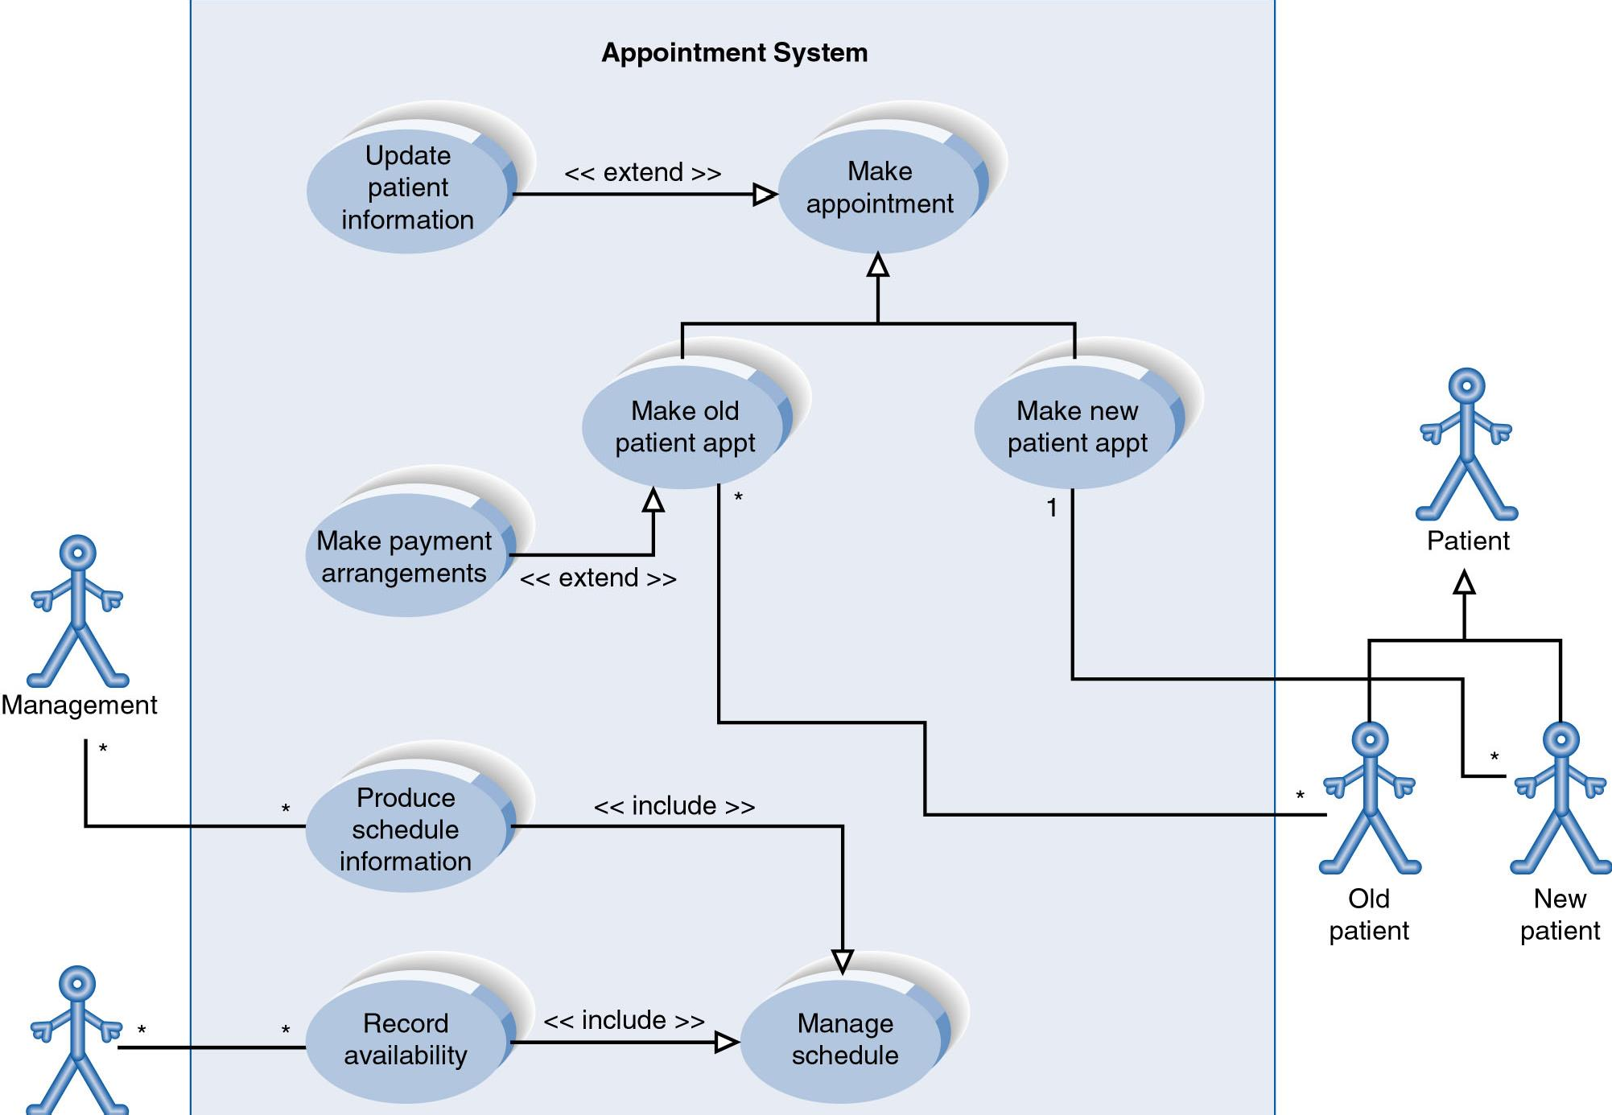

Slide 40

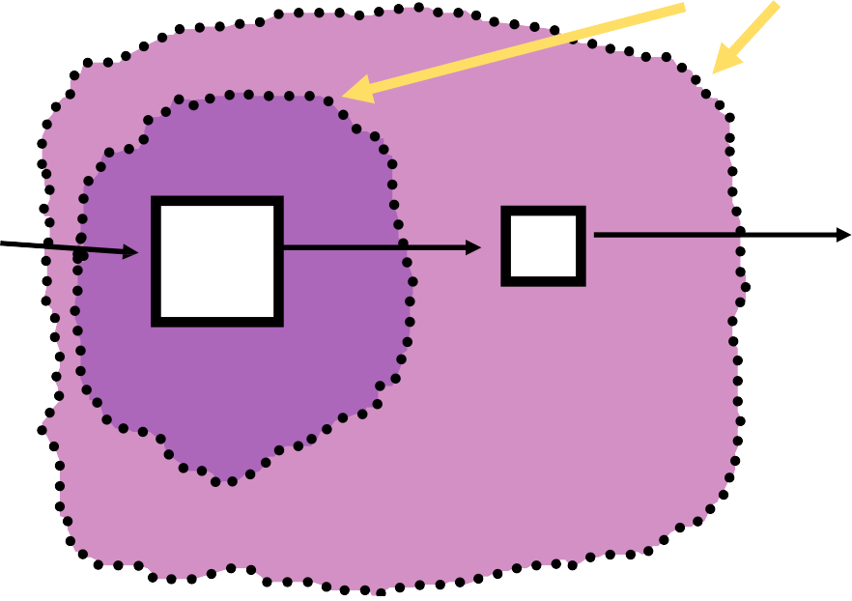
The concept of an Actor
  An Actor represents anything outside the system that interacts with the system
The concept of a Use Case
  A Use Case instance is a sequence of transactions performed by the system, which is initiated by a particular actor and yields a meaningful, measurable result
of value to a particular actor.
The concept
of a Boundary
Answering Machine (voice mail)
Simple Phone System

Slide 41

The concepts of a scenario
 A scenario describes what happens during an actual occurrence of a use case.
The anatomy of a use case
Special Requirements
Name
Brief Description
A
-
-
ssociations to Actors
Use Cases
A Use Case
Flow of Events
Pre/Post Conditions, Activation & Termination

Slide 42

Inheritance- associations between actors
Generalization - Extracting common ways of two or more actors to use the system.
Assign these common ways of using the
system to an ancestor actor.
Uses-associations between use-cases
Extends- associations between use-cases
Shows parts of behavior in several use cases that are common
Models optional behaviour in a separate use case

